Slide 1



Peoples Gas & Pitt CSB
Resilience Strategies Labs Project:
Hydrogen Market Opportunities and Data Center Analysis​
Author: Priyam Somani, MSBA Class of 2025
Affiliations: Essential Utilities – Peoples Natural Gas, in collaboration with the University of Pittsburgh Center for Sustainable Business

Slide 2

Part 1: Hydrogen Blending Project
Project Executive Summary
Market Research & Technology Overview
SWOT Analysis
Key Findings
Recommendations
2

Slide 3

Executive Summary
Problem Statement
Peoples Gas is under growing pressure to decarbonize its natural gas distribution system to meet ESG goals and comply with Pennsylvania’s evolving emissions regulations. Hydrogen blending—injecting low-carbon hydrogen into natural gas pipelines—presents a near-term, infrastructure-compatible strategy to reduce GHG emissions. However, key questions remain around safety, material compatibility, regulatory readiness, and public acceptance.
Approach
Conducted through the CSB Fellowship, Phase 1 focused on technical feasibility, regulatory benchmarking, and community integration:
Evaluated H Quest's turquoise hydrogen (via microwave plasma pyrolysis) for cost, energy efficiency, and carbon co-product value. (a)
Assessed pipeline material compatibility (steel, PE100-RC, FRP) for low-level blending
Compared Peoples’ ESG strategy and hydrogen activity with SoCalGas, UGI, Columbia, Dominion
Analyzed best practices for pilot design, public engagement, and leak detection technologies
Key Findings
H Quest’s hydrogen is energy-efficient and offers potential for cost-effectiveness (projected <$2/kg), especially when factoring in the value of graphene and carbon co-products used in clean-tech applications. (a)
Infrastructure-ready: Up to 20% hydrogen blends are compatible with Peoples’ pipeline materials
Visibility Opportunity: Peoples can boost its leadership by launching public-facing hydrogen pilots and outreach efforts
ESG opportunity: Hydrogen blending supports emissions reduction, improves ESG ratings, and aligns with stakeholder expectations
Strategic Recommendations
Launch a second pilot modeled after SoCalGas → Complements the H Quest project, builds public trust, and strengthens regulatory and funding credibility
Scale Hydrogen + RNG supply with H Quest → 10-20% GHG reduction potential in targeted areas
Launch a comprehensive public education campaign → Builds on existing outreach to deepen community trust, reduce opposition, and improve long-term project viability
Engage PUC on green gas pricing → Unlocks opt-in revenues and supports long-term ratepayer value
Executive Summary
Recommendations
Market Research
Key Insights
SWOT Analysis
3

Slide 4




Market Research & Technology Overview
Hydrogen Production Trends
Utility Benchmarking
Policy Drivers
Public Sentiment & Technology
Green and turquoise hydrogen are gaining policy and investment support as clean alternatives to grey hydrogen.
Turquoise hydrogen, as piloted by H Quest, uses methane pyrolysis and yields both hydrogen and valuable carbon byproducts. It requires significantly less energy than electrolysis.
SoCalGas: Advanced in hydrogen blending (up to 20%), strong public engagement, and infrastructure modernization.
UGI: Investing in RNG and hydrogen pilots, demonstrating flexible fuel sourcing.
Dominion: Integrating carbon capture with hydrogen, aiming for net-zero distribution.
Columbia Gas: Actively upgrading pipelines for hydrogen readiness.
Pennsylvania’s carbon reduction targets and federal incentives (Infrastructure Investment and Jobs Act) offer funding for hydrogen infrastructure.
Section 1307(f) rate constraints prevent traditional cost pass-throughs for hydrogen, creating a need for new pricing models.
Low public awareness of hydrogen blending in Pennsylvania compared to California; risk of opposition if not proactively addressed.
Track record of safety in global markets (e.g., Hawaii Gas, France, UK, Netherlands) supports feasibility.
Executive Summary
Recommendations
Market Research
Key Insights
SWOT Analysis
4

Slide 5
SWOT Analysis of Peoples Natural Gas and H Quest
Strengths
Innovative microwave plasma pyrolysis, low energy consumption, valuable carbon by-products.
Produces "turquoise" hydrogen with zero CO2 emissions and reduced costing because of methane pyrolysis.
Large customer base across PA, WV, and KY with existing infrastructure.
Active pipeline modernization and safety compliance.
ESG commitments (60% GHG reduction by 2035).
Partnership with H Quest and University of Pittsburgh for innovation.
Weaknesses
Infrastructure limitations, pressure inconsistencies during blending, risk of leaks due to hydrogen's small molecular size.
Long-term pipeline material degradation is still under evaluation — including risks like hydrogen embrittlement and corrosion over time
Operational challenges during blending include pressure fluctuations and potential impacts on flow stability
Lack of current hydrogen-dedicated public outreach and pilot visibility.
Regulatory limitations under Section 1307(f).
Limited hydrogen expertise among staff; needs training programs.
S
W
O
Opportunities
Establish leadership in hydrogen blending within the Northeast.
Monetize carbon by-products from turquoise hydrogen.
Participate in hydrogen hubs and state-funded decarbonization projects.
Leverage existing smart meter rollouts and leak detection upgrades for hydrogen monitoring.
Threats
Flammability risk, evolving regulations.
Competitor utilities progressing faster; risk of losing innovation leadership.
Regulatory pushback or lack of policy support for hydrogen cost recovery.
Public skepticism about hydrogen safety without transparent engagement.
T
Executive Summary
Recommendations
Market Research
Key Insights
SWOT Analysis
5

Slide 6
Key Insights
H Quest Turquoise Hydrogen Pilot
Material Compatibility
Insight:
Produces hydrogen efficiently using microwave plasma pyrolysis; yields valuable carbon byproducts like graphene and carbon black.
Insight:
PE100-RC plastic and 316L stainless steel perform well under hydrogen exposure.
Implication:
Offers Peoples a cost-effective, low-carbon hydrogen source made in Pennsylvania, avoiding reliance on high-cost green hydrogen imports. Carbon byproduct valorization creates new revenue streams that could subsidize hydrogen production and reduce customer rate impacts.
Implication:
A large portion of Peoples’ existing network is already hydrogen-ready. Targeting these segments first enables a phased rollout of blending with minimal capital investment.
Insight:
Existing infrastructure can accommodate low-level hydrogen blending with minimal modification.
Insight:
Older bare steel requires replacement; FRP (fiber-reinforced plastic) can be used for expansion areas.
Implication:
Accelerates deployment timeline—Peoples can introduce hydrogen incrementally using current system components, allowing for lower-risk pilots without major upfront infrastructure overhauls.
Implication:
Helps Peoples identify priority upgrade zones and long-term capex planning—while new builds can adopt FRP to future-proof infrastructure at lower cost than high-grade steel.
Executive Summary
Recommendations
Market Research
Key Insights
SWOT Analysis
6

Slide 7
Key Insights Continued
ESG & Regulatory Fit
Leak Detection Technologies
Insight:
Hydrogen supports Peoples’ 2035 GHG goals and Essential Utilities’ decarbonization roadmap.
Insight:
Tools like OGI cameras, satellite detection (GHGSat, Kayrros), and AI-based MultiSensor platforms offer precise, real-time gas monitoring.
Implication:
Strengthens ESG disclosures and investor appeal; early adoption builds leadership credibility in PA’s clean energy space.
Implication:
Enhances safety, operational transparency, and regulatory compliance in a hydrogen-blended system—while also reducing methane leaks, aligning with methane intensity goals and EPA rules. Investment here demonstrates proactive risk management.
Public Engagement Models
Insight:
Current rate structures don’t support hydrogen cost recovery.
Insight:
SoCalGas’ Orange Cove pilot successfully gained community trust through home appliance checks, local workforce training, and open data sharing.
Implication:
Highlights need for PUC engagement and green gas pricing models to enable cost pass-through and unlock future revenue.
Implication:
Peoples can adopt similar engagement strategies to preempt public pushback, improve local acceptance, and build a replicable template for future pilots across its service territory.
Executive Summary
Recommendations
Market Research
Key Insights
SWOT Analysis
7

Slide 8
Recommendations and Next Steps
Launch a Pilot
Launch a second community-facing hydrogen blending pilot modeled after SoCalGas — incorporating home appliance testing, workforce training, and transparent data sharing — to complement the H Quest pilot, demonstrate operational feasibility, strengthen public trust, and build regulatory and federal funding credibility.
Support and Enable H Quest
Support and enable H Quest to expand its turquoise hydrogen production capacity by facilitating infrastructure, policy alignment, and commercialization of carbon byproducts like graphene and carbon black — ensuring local supply chain resilience, reducing production costs, and maintaining affordable customer rates.
Regulatory Cost Recovery Path
File a hydrogen opt-in rider with the Pennsylvania PUC and formally engage in the MACH2 hydrogen hub working groups—creating a proactive regulatory strategy that secures early cost recovery mechanisms, positions Peoples for federal infrastructure funding, and builds long-term ratepayer value.
Deploy Leak Detection Systems
Deploy leak detection systems using advanced technologies: optical gas imaging (OGI), AI-powered MultiSensor, and satellite platforms like GHGSat — transitioning from legacy inspection methods to a predictive, real-time monitoring approach that enhances public safety, ensures compliance, and supports ESG disclosures.
Educate the Public
Expand public education and transparency efforts through coordinated town halls, in-home pilot updates, and utility bill communications — broadening awareness, minimizing local resistance, and reinforcing Peoples’ reputation as a customer-first, innovation-driven utility.
Executive Summary
Recommendations
Market Research
Key Insights
SWOT Analysis
8

Slide 9
Part 2: Data Centers Strategy
Project Executive Summary
Market Research
Key Insights & Rate Structure Benchmarking
Marketing Campaign
Recommendations
9

Slide 10
Executive Summary
Problem Statement
How can Peoples Natural Gas position itself as a preferred energy provider for hyperscale data centers in a rapidly evolving energy and digital infrastructure landscape—while competing with established electric utilities, and leveraging its abundant natural gas resources and infrastructure footprint in Western Pennsylvania?
Approach
We benchmarked Pittsburgh against top data center markets (e.g., NoVA, Silicon Valley, Dallas) across six critical factors to assess Peoples Gas’s positioning:
Utility Rates: Compared large-load electric and gas tariffs (Dominion, Duquesne, West Penn) to evaluate cost competitiveness.
Fiber Infrastructure: Reviewed fiber density, dark fiber access, and proximity to major carrier hotels.
Real Estate & Incentives: Identified retired coal sites and reviewed tax programs and permitting policies.
Talent Ecosystem: Analyzed local AI, cloud, and engineering talent from CMU, Pitt, and regional startups.
Gas-Based Power Potential: Mapped sites for on-site co-gen leveraging Peoples Gas distribution (e.g., Bruce Mansfield, Elrama).
Key Findings
Lead Time to Procure Data Center Power: Pittsburgh offers one of the shortest lead times in the U.S. at just 36 months. (per reference A)
Cost Advantage: Behind-the-meter gas enables ~$65.08/MWh, beating Dominion ($92.89) and competitive with West Penn.
Fiber Connectivity Clusters in PA: Pittsburgh and Philadelphia have dense, multi-provider fiber networks, while areas like Harrisburg show moderate coverage and less redundancy.
Energy Security: PA is the #2 gas producer; 53% of electricity is gas-powered—ideal for reliable co-gen.
Redevelopment Potential: Legacy sites (e.g., Homer City) offer turnkey 345kV infrastructure for data center conversion.
Strategic Recommendations
Develop a Playbook
Package Peoples’ strengths into a “Pittsburgh Hyperscale Toolkit” with co-gen options, rate comparisons, and site maps.
Repurpose Legacy Coal Plant Sites
Focus on sites for data center redevelopment with grid tie-ins and gas supply.
Advocate for Data Center Incentives
Collaborate with public agencies to secure tax exemptions, credits, and permitting acceleration.
Leverage Pittsburgh’s Talent & Innovation Ecosystem
Highlight CMU/Pitt pipeline and local AI/cloud strengths in partnership proposals.
Builds a competitive identity to rival NoVA, Columbus, and Dallas.
Delivers turnkey sites with integrated land, power, and infrastructure.
Enhances affordability and market competitiveness.
Boosts data center value and reinforces Pittsburgh’s tech brand.

Slide 11

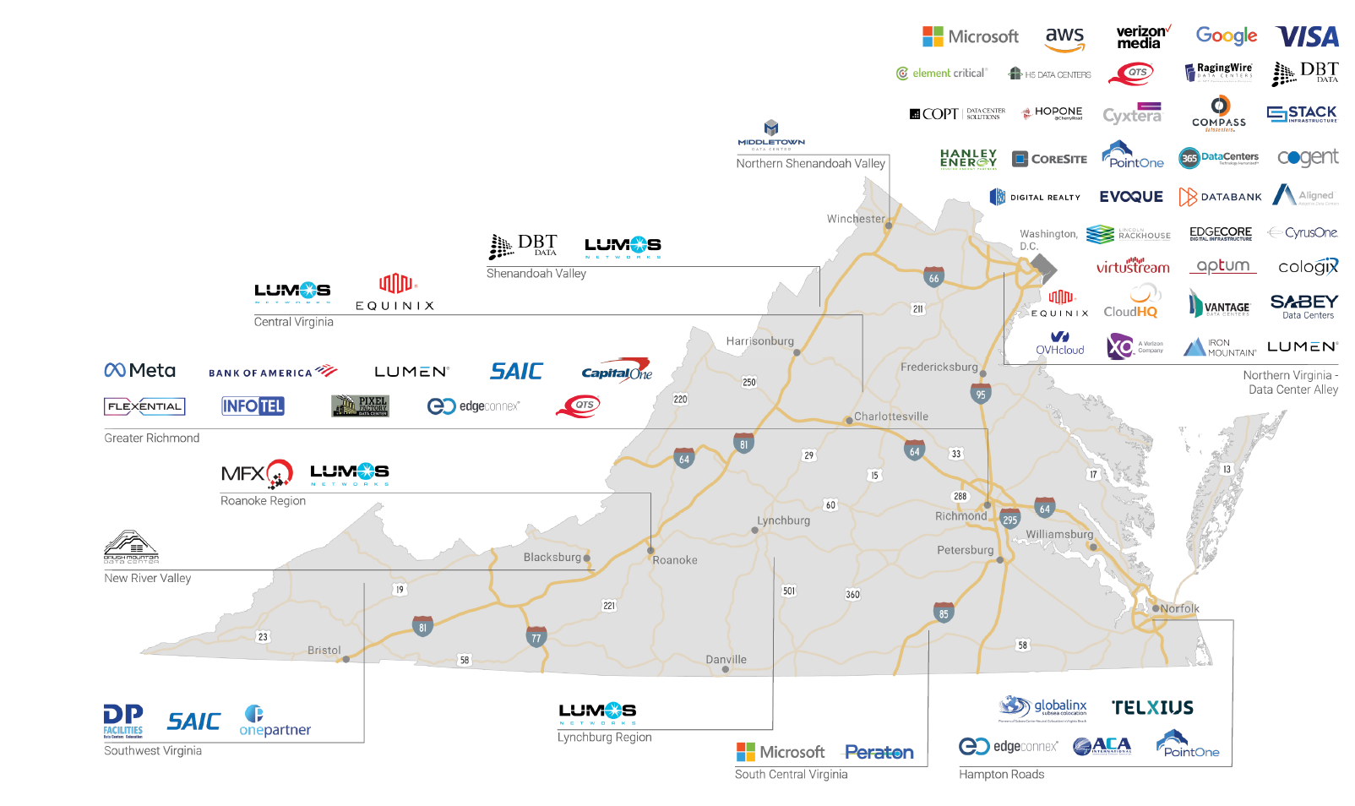




Data Center Market Research: Why Virginia?
Global Leader with Strategic Concentration:
Virginia hosts 150+ hyperscale data centers, accounting for over 35% of global market share, anchored in Loudoun County’s “Data Center Alley”, which handles ~70% of the world’s internet traffic.
Elite Infrastructure & Connectivity:
The region offers the highest density of dark fiber globally, with ultra-fast, redundant networks and reliable grid access — ideal for hyperscale and cloud operations.
Business-Friendly with Strong Incentives:
Virginia provides competitive electricity rates, fast permitting, and sales tax exemptions on qualifying data center equipment, creating a highly attractive investment climate.
Home to Major Hyperscalers:
Industry leaders like AWS, Microsoft, Google, Equinix, and CyrusOne operate large-scale campuses, reinforcing the region’s reputation and ecosystem strength.
Reference Link: Virginia Data Centers Locations
Emerging Secondary Hubs:
Areas like Richmond’s White Oak Technology Park are gaining traction, with Meta and Bank of America leading new hyperscale developments beyond Northern Virginia.
Executive Summary
Recommendations
Market Research
Marketing
Key Insights
11

Slide 12
Key Insights
Infrastructure Advantage
Grid and Renewable Outlook
Regional Saturation Elsewhere
Insight:
Sites like Bruce Mansfield & Mitchell Power Station offer 345kV tie-ins; PA has ample former coal plant land and pipeline access.
Insight:
Behind-the-meter gas generation offers lower, more stable rates than grid power.
Insight:
Northern Virginia, Dallas, Silicon Valley face grid strain and land scarcity.
Implication:
Peoples can offer turnkey sites with integrated energy delivery, making it easier to co-locate gas-powered data centers.
Implication:
Creates a competitive energy pricing edge, helping Peoples attract hyperscalers seeking long-term cost control.
Implication:
Opens a first-mover window for Peoples to attract demand from hyperscalers priced or timed out of saturated markets.
Power Affordability
Short Deployment Timelines
Proximity to Demand + Resilience
Insight:
Behind-the-meter gas generation offers lower, more stable rates than grid power.
Insight:
Pittsburgh offers a faster deployment timeline — with data center power averaging ~36 months, compared to 5–7 years in other major markets.
Insight:
Pittsburgh is close to major East Coast metros and has lower climate risk.
Implication:
Creates a competitive energy pricing edge, helping Peoples attract hyperscalers seeking long-term cost control.
Implication:
Positions Peoples as an accelerator for deployment, shortening time-to-market for digital infrastructure clients.
Implication:
Peoples can market sites as resilient, disaster-safe locations with strategic access to growing data needs.
Executive Summary
Recommendations
Market Research
Marketing
Key Insights
12

Slide 13
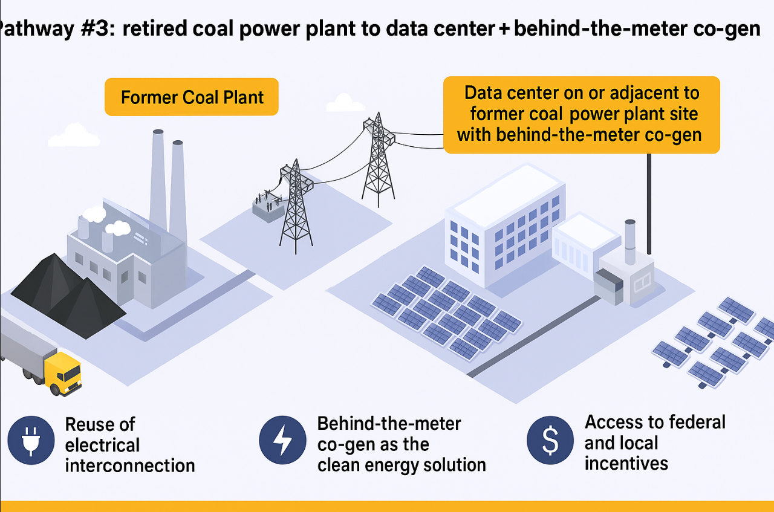
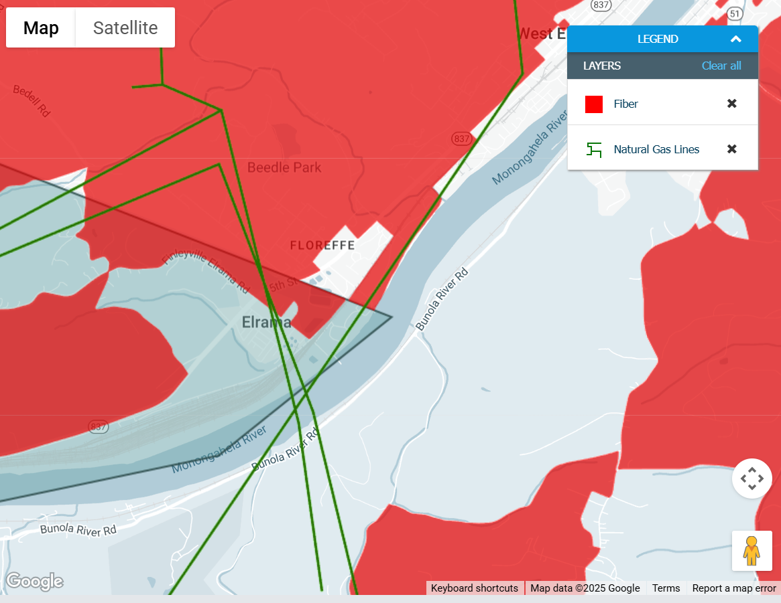
Coal Sites: Retired Sites as Data Center Campuses
Reuse of Electrical Interconnection
Existing high-voltage tie-ins (e.g., 345kV at Homer City, Bruce Mansfield) reduce interconnection delays and cost.
Enables rapid deployment of energy infrastructure at brownfield sites.
Behind-the-Meter Co-Gen as a Clean Energy Solution
Retrofit natural gas-powered CHP systems directly adjacent to data centers to generate both electricity and thermal energy.
The excess heat can be captured and used to drive absorption or absorption chillers – providing efficient cooling and reducing overall energy consumption.
Source: DCED Link
Access to Incentives
EPA Brownfields: Grants for site assessment, planning, and remediation.
IRA Tax Credits: CHP systems may qualify for PTC/ITC if using hydrogen/RNG.
State/Local: KOZ, LERTA, and sales tax exemptions on data center equipment.
Strategic Fit with Peoples Gas Goals
Showcase Opportunity: Use sites like Mitchell, Homer City, or Elrama as pilots.
Marketing Value: Promote Peoples as a clean infrastructure partner vs just a utility.
Policy Engagement: Work with DCED and PEDA to package turnkey offerings.
Key Takeaway for Peoples Gas:
Retired coal plants offer a fast, infrastructure-rich foundation for hyperscale deployment with minimal permitting friction—backed by incentives, fuel access, and built-in grid connectivity.
13

Slide 14
Competitive Rate Analysis
Approach & Methodology:
Analyzed large-load utility tariffs for 300 MW data center demand (~2.6B kWh/year)
Modeled Peoples Gas behind-the-meter generation using realistic fuel and O&M costs
Converted natural gas costs to electricity equivalent using:
Heat rate: 0.00936 MMBtu/kWh
Gas heating value: 1.037 MMBtu/Mcf
Included all applicable charges: delivery, riders, retainage, and GRT
Benchmarked against utility electric rates for Dominion, Duquesne, West Penn
Strategic Implications
Control over energy economics: Avoids volatile grid charges (capacity, PJM, demand riders)
Speed to serve: On-site co-generation deploys faster than grid interconnection
Customer value proposition: Custom energy pricing undercuts regional electric utilities
Scalability: Model can be replicated at retired coal sites with pipeline access
Energy independence: Behind-the-meter ensures reliability during grid instability.
Reference – (e) & (f)
Executive Summary
Recommendations
Market Research
Marketing
Key Insights
14

Slide 15
Competitive Rate Analysis for Hyperscale Data Centers
Key Takeaway
Peoples Gas offers the most competitive, stable behind-the-meter cost at $65.08/MWh, outperforming Dominion ($92.89), West Penn ($86.11), and Duquesne Light ($80.36) when considering full power plant O&M.
Utility Provider | Total Cost ($/MWh) | Highlights
Peoples Gas (B-T-M) | $65.08 | Lowest volatility, bypasses grid congestion and transmission risk
Duquesne Light | $80.36 | Grid-tied, layered fixed + rider costs, demand-based rate components
West Penn Power | $86.11 | Includes grid losses and gross-up from PJM, slightly above Peoples
Dominion Energy | $92.89 – $114.23 | Peak pricing risk, layered surcharges, slow interconnection process
Peoples Gas Rate Structure, Large General Services
 | Total | Description
Commodity Cost ($/mcf) | $ 2.2500 | Base cost of natural gas purchased from Peoples Gas
Delivery charge ($/mcf) | $ 1.4431 | Tier 3 delivery rate for >2M Mcf/year customers
Balancing Charge ($/mcf) | $ 0.2345 | Fee for balancing supply and demand on pipeline
Universal Service Rider (USR) | $ 0.6055 | Required unless exempt
Merchant Function Charge (MFC) | $ 0.0113 | Applies for GS-S customers
Supplier Choice Rider | $ 0.00800 | Applies to all sales service
Total | $ 4.55240
Retainage Adjustment (5.8%) | $ 0.2640 | Additional gas needed due to system losses (5.8%)($4.5524 × 5.8%)
Total | $ 4.8164
Operating Cost of the power plant (mWh) | $15 to $25 | Typical for on-site behind-the-meter systems
Total per MCF ($/mcf) | $ 4.8164
Total per Kwh ($/kwh) | $ 0.045082 | Heat rate = 0.00936
Total per Mwh ($/Mwh) | $ 45.08
With O&M cost of Power Plant (mWh) | $ 20.00
Total per kWh ($/kWh) | $ 0.065082
Total per mWh ($/mWh) | $ 65.08
Executive Summary
Recommendations
Market Research
Marketing
Key Insights
15

Slide 16
Marketing Campaign
Campaign Objective
Channel | Execution Strategy
LinkedIn (sponsored content) | Target hyperscaler execs, site leads, energy infrastructure planners
Data Center Trade Shows | DCD, Data Center World, Bisnow – poster, pitch deck, booth collateral
Digital Media / Banner Ads | Placements in Data Center Frontier, Uptime Institute, TechCrunch Infrastructure
B2B Microsite | pghhyperscale.com → GIS maps, rate calculator, site specs, ROI simulator
Direct Outreach | Custom pitch decks and case studies for AWS, Meta, Google – use lead time + rate edge
Local Ecosystem Events | Host a “Pittsburgh Data Center Summit” with PEDA, DCED, tech firms, and energy partners
Position Peoples Gas as the preferred energy partner for hyperscale and enterprise data centers seeking low-cost, resilient, and ESG-aligned power solutions—with Pittsburgh as the ideal expansion hub.
Core Messaging
Why Peoples Gas?
$65.08/MWh behind-the-meter power—lower and more stable than Dominion or West Penn
Custom natural gas co-gen (CHP) at the site → no grid dependency
Transparent rate structure with optimization options (O&M, fuel contracts)
Eligible for IRA tax incentives (e.g., hydrogen, RNG, CHP)
What does Peoples Gas Provide?
End-to-end energy infrastructure support: pipelines, turbines, site coordination
Access to former coal plant campuses (e.g., Mitchell) with 345kV tie-ins (c)
Co-development model with data centers for tailored energy + land package
Regulatory flexibility and project modeling for long-term cost control
Examples in Appendix: Peoples Natural Gas flyers
Executive Summary
Recommendations
Market Research
Marketing
Key Insights
16

Slide 17
Recommendations and Next steps
Develop a Pittsburgh Hyperscale Playbook
Develop a Pittsburgh hyperscale playbook by creating a clear, strategic internal and external guide —featuring rate comparisons, co-generation options, coal sites redevelopment, and infrastructure overlays — to help Peoples Gas present a unified, market-ready value proposition to hyperscalers and accelerate business development.
Repurpose Retired Coal Sites as Power-Ready Campuses
Repurpose retired coal Sites as power-ready campuses by identifying high-potential locations like Mitchell and Homer City, leveraging Peoples’ pipeline access and existing grid tie-ins, and partnering with the state to secure EPA grants and tax incentives — transforming underutilized brownfields into revenue-generating, hyperscale-ready energy campuses.
Advocate for Data Center Incentives
Advocate for Data Center incentives by partnering with the Pennsylvania Department of Community and Economic Development (DCED), Pennsylvania Energy Development Authority (PEDA), and local governments to push for Keystone Opportunity Zone (KOZ) eligibility, sales tax exemptions on servers and cooling equipment, and streamlined permitting — strengthening Pittsburgh’s economic competitiveness.
Leverage Pittsburgh’s Talent & Innovation Ecosystem
Leverage Pittsburgh’s talent & innovation ecosystem by promoting access to top-tier cloud, AI, and cybersecurity talent from Carnegie Mellon University and the University of Pittsburgh, while partnering on innovation labs and R&D initiatives to attract hyperscalers and position Peoples Gas as an embedded infrastructure and technology collaborator.
Executive Summary
Recommendations
Market Research
Marketing
Key Insights
17

Slide 18
Appendix

Slide 19
Appendix Part 1: Hydrogen Blending Project
19

Slide 20
Recommendations and Next Steps: PA Hydrogen Blending Project
Launch a Community Hydrogen Blending Pilot
What: Implement a phased hydrogen blending pilot (0.1% → 5%) in a residential community (~10,000 people) in Western Pennsylvania.
Specific Actions:
Identify target zone with high PE100-RC or compatible pipeline materials.
Partner with local fire departments & emergency services to develop a hydrogen safety protocol and training curriculum.
Conduct free in-home appliance inspections to test for blend compatibility.
Install smart gas meters to collect granular consumption and pressure data.
Submit a PUC filing for a limited-scope pilot exemption or cost recovery test case.
Why It Is Recommended:
Demonstrates safe, real-world feasibility to regulators and the public.
Generates high-quality data to inform future blending and rate proposals.
Builds community trust and opens a path to scaling hydrogen blending across the network.
Enhances eligibility for DOE community-scale pilot funding.
Value for Peoples Natural Gas
Builds regulatory credibility → higher chance of DOE funding (up to $5–10M)
Generates real-world safety + performance data for PUC filings
Enhances community trust, reducing project delays
20

Slide 21
Recommendations and Next Steps: PA Hydrogen Blending Project
Scale Hydrogen Production with H Quest
What: Support expansion of H Quest’s turquoise hydrogen output and create a business case for carbon byproduct monetization.
Specific Actions:
Negotiate an offtake agreement with H Quest to secure a consistent, local hydrogen supply for blending trials.
Co-develop a grant proposal with H Quest for scaling microwave plasma units under DOE's Hydrogen and Fuel Cell Technologies Office (HFTO).
Explore carbon co-product commercialization (graphene, carbon black) with partners in advanced materials, construction, or tech sectors.
Coordinate pipeline interconnects for blending sites, ensuring compression and storage capabilities match phased pilot needs.
Why It Is Recommended:
Secures a cost-effective, clean hydrogen source made in Pennsylvania.
Enhances long-term supply chain resilience and localization.
Monetizing carbon co-products lowers the effective cost of hydrogen, easing pressure on customer rates.
Value for Peoples Natural Gas
Secures a local hydrogen supply, reducing dependence on high-cost green H₂.
Offsets production costs via co-product sales, improving NPV.
Positions Peoples as a technology partner, not just a buyer.
Ref (b)
21

Slide 22
Recommendations and Next Steps: PA Hydrogen Blending Project
Align Hydrogen Planning with Pipeline Modernization
What: Integrate hydrogen-readiness into existing pipeline replacement and expansion efforts.
Specific Actions:
Prioritize hydrogen-compatible material installation (PE100-RC, FRP) in areas identified for future hydrogen pilots or scaling.
Develop a GIS-based asset map of hydrogen-ready pipeline segments to support strategic planning and regulatory filings.
Incorporate hydrogen specifications into procurement standards for new pipe materials and valves.
Apply for infrastructure co-funding through DOE’s Clean Energy Infrastructure and Resilience Programs.
Why It Is Recommended:
Leverages ongoing investments to build hydrogen compatibility at no marginal cost.
Avoids expensive retrofits later by planning ahead now.
Creates a pipeline network that supports future blending or 100% hydrogen distribution in select zones.
22

Slide 23
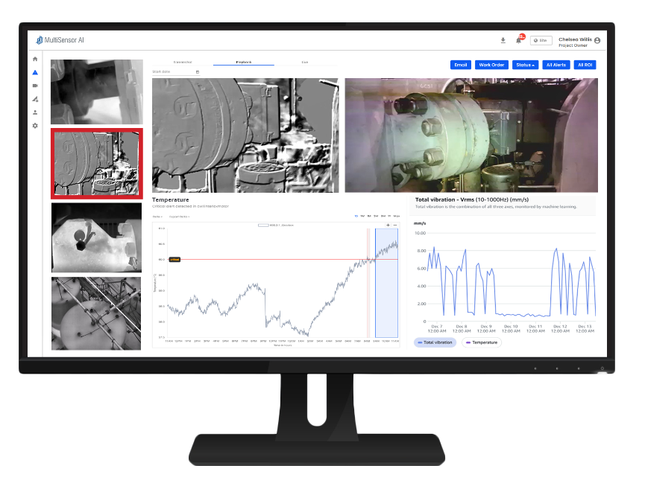

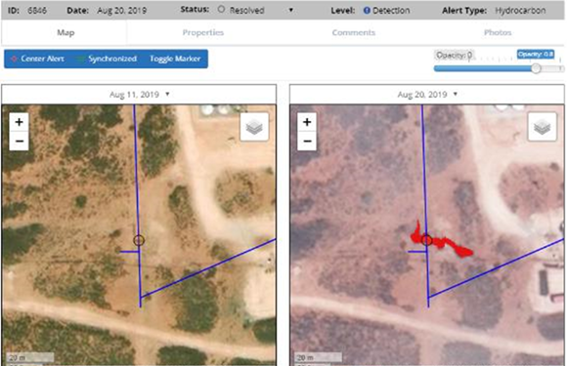
Recommendations and Next Steps: PA Hydrogen Blending Project
Adopt Advanced Leak Detection Technologies
What: Implement high-precision leak detection systems focused on hydrogen and methane risk areas.
Specific Actions:
Deploy Optical Gas Imaging (OGI) cameras and MultiSensor AI platforms at compressor stations and key junctions.
Subscribe to GHGSat or Kayrros for satellite-based methane and hydrogen plume detection and regional surveillance.
Apply for detection tech funding under PHMSA and DOE safety programs.
Report leak detection performance in ESG metrics and sustainability reports.
Why It’s Recommended:
Enhances public safety and hydrogen pilot confidence.
Supports compliance with EPA methane rule updates and upcoming hydrogen-specific regulations.
Bolsters ESG disclosures and demonstrates technology-forward risk management.
Value for Peoples Gas
Reduces methane loss and potential fines under EPA methane rule.
Improves ESG scores, supporting investor and regulatory confidence.
Enhances public safety and long-term operational resilience.
23

Slide 24
Recommendations and Next Steps: PA Hydrogen Blending Project
Strengthen and Strategically Leverage Regulatory Engagement
With the Pennsylvania PUC:
File for a Pilot Tariff: Propose a green gas pilot rider or tariff allowing a subset of customers to opt into hydrogen-blended service at a premium rate. Include cost-benefit modeling and a clear customer education plan.
Initiate a Collaborative Docket: Request a PUC-sponsored working group or docket on decarbonized gas pathways. This creates a formal venue for shaping hydrogen cost recovery and performance standards.
Submit a Hydrogen Safety and Cost Recovery Plan: Include hydrogen as part of Peoples' broader modernization filing or rate case—detailing safety protocols, cost tracking methods, and anticipated customer impact.
Request Regulatory Flexibility: Seek waivers or phased cost recovery mechanisms to cover R&D, monitoring, and pilot deployment without full rate case delays.
With DOE Hydrogen Hub Partners:
Apply for Pilot Demonstration Grants: Target specific FOAs (Funding Opportunity Announcements) under the Mid-Atlantic Hydrogen Hub (MACH2) for community-scale blending pilots or infrastructure R&D.
Formalize Utility Participation: Pursue an MOU or partnership framework with MACH2 leadership to ensure Peoples Gas is a named partner in deployment activities, enhancing visibility and funding access.
Share Use Case Data: Provide DOE with data on blending feasibility, material performance, and customer feedback from any pilot zones—positioning Peoples as a data partner that can inform national standards.
24

Slide 25
Recommendations and Next Steps: PA Hydrogen Blending Project
Public Outreach & Education
What: Launch a community-facing education campaign to build awareness and trust in hydrogen blending.
Specific Actions:
Create a dedicated microsite or dashboard to show real-time pilot data, FAQs, safety updates, and blending progress.
Host town halls and virtual Q&A events with customers, first responders, and local officials.
Partner with local universities and schools to offer hydrogen awareness curriculum and engagement programs.
Develop infographics, videos, and bill inserts explaining hydrogen benefits and safety.
Why It Is Recommended:
Builds community trust, a critical factor in successful pilot execution.
Reduces resistance from residents, officials, and media by promoting transparency.
Enhances Peoples' public image as an innovative and responsible utility.
25

Slide 26
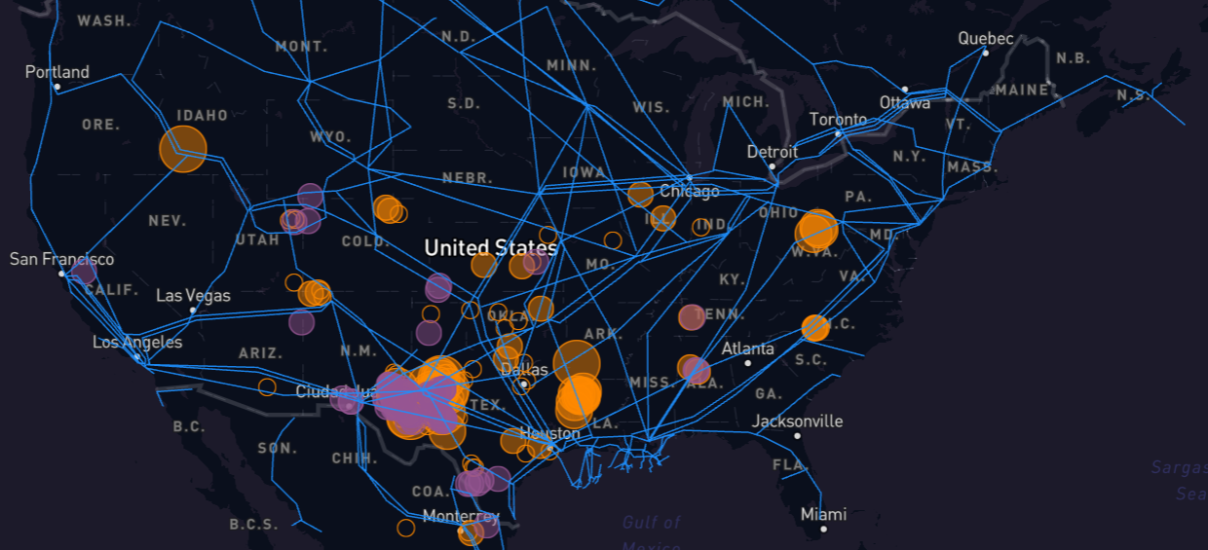
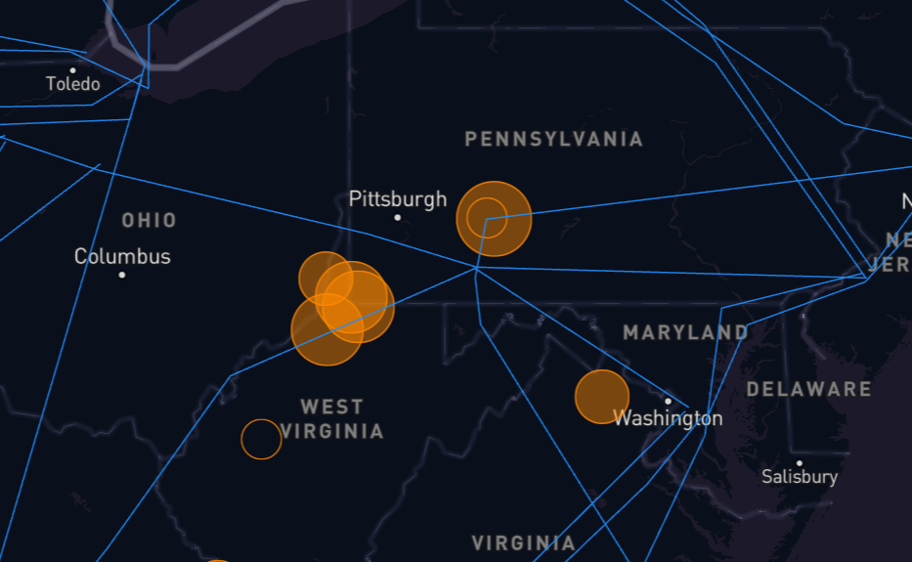
Methane Watch - Kayrros
https://methanewatch.kayrros.com/map
26

Slide 27
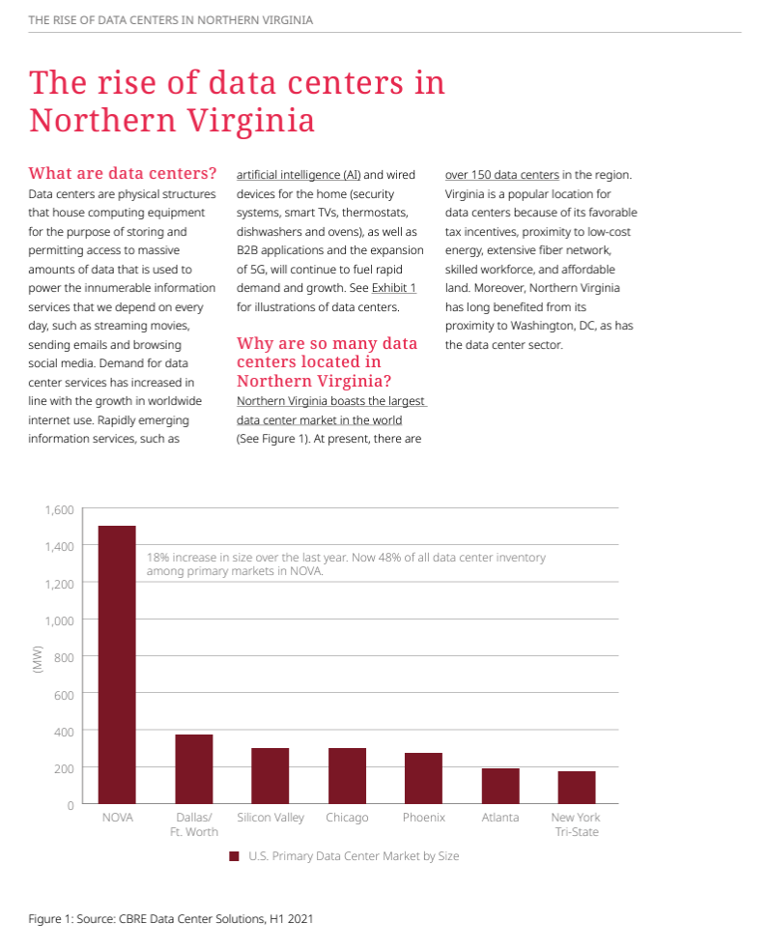
References: PA Hydrogen Blending Project
https://infraredcameras.com/ (Infrared Cameras)
https://www.flir.com/instruments/optical-gas-imaging/?form=MG0AV3
What is Optical Gas Imaging? Explanation in a nutshell… - Opgal
https://www.ghgsat.com/en/ , https://www.kayrros.com/, https://www.satelytics.com/solutions/pipeline
The power of AI: How oil/gas companies are using AI-powered geospatial analytics to identify and prevent potential leaks | Gas Processing & LNG (gasprocessingnews.com)
https://www.datacenters.com/news/why-northern-virginia-dominates-the-data-center-market-who-s-building-and-where
https://blog.vantage-dc.com/2020/08/21/what-made-northern-virginia-the-worlds-largest-data-center-market/
https://www.dominionenergy.com/virginia/rates-and-tariffs/business-rates - Rates of Dominion
https://www.pecva.org/our-work/energy-matters/data-centers-energy-demand/
https://datacenterhawk.com/resources/market-insights/why-the-northern-virginia-data-center-market-keeps-growing
27

Slide 28
Appendix Part 2: Data Centers Strategy
28

Slide 29
Data Center Market Research: Northern Virginia Incentives
Unmatched Power Availability & Reliability
Northern Virginia offers ready access to 100–300+ MW of power with proven grid reliability, reducing delays and uncertainty for hyperscalers.
Superior Fiber Connectivity
Ashburn, VA is the world’s top internet exchange point with dense dark fiber and direct global routing—critical for latency-sensitive workloads.
Incentives and Policy Support
Virginia offers targeted tax breaks on equipment and electricity use, making long-term operations significantly cheaper for data center tenants.
Workforce Specialization
NoVA boasts a large, experienced talent pool in cloud infrastructure and operations, reducing staffing risks for hyperscale builds.
Risk Aversion & Brand Preference
Hyperscalers prefer expanding in NoVA due to existing investments, proven suppliers, and reduced operational risk compared to newer markets like Pittsburgh.
Executive Summary
Recommendations
Market Research
Marketing
Key Insights
29

Slide 30
Benchmarking Best-in-Class Data Center Infrastructure: Virginia
Used as a reference model for infrastructure standards, fiber density, and energy readiness when evaluating Pittsburgh’s potential to attract hyperscale development.
"White Oak Technology Park is a master-planned, publicly owned industrial park located at the intersection of I-64 and I-295 in tax-friendly Henrico, Virginia. The 2,278-acre park boasts the extensive and reliable power, utility, and transportation infrastructure demanded by today's most advanced manufacturing facilities and data centers. With +/- 470 acres of build-ready industrial land remaining, White Oak Technology Park is one of the premier development opportunities on the East Coast of the U.S."
Electric, fiber, water, sewer, gas, and transportation networks will meet almost any need.
Served by a networked (dual feed) 230kV transmission system with multiple distribution substations and 34.5kV circuit
10 MGD water and 13 MGD sewer capacity throughout the park
Natural gas system with high and intermediate pressures with 24 to 150 PSI on site
Extensive fiber network, including Comcast, Level 3 Communications, Lumos Networks, SummitIG, Verizon, Windstream Corp., Zayo Group & other providers
30

Slide 31
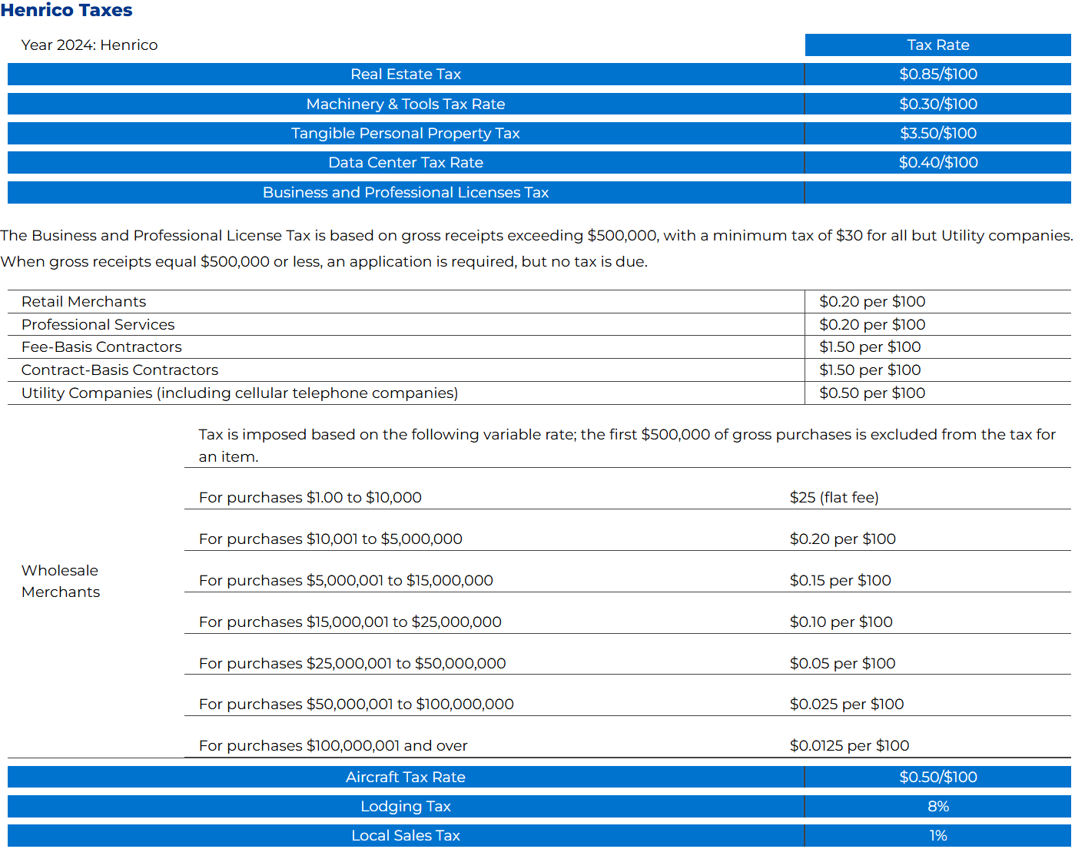
Policy Benchmark: Competitive Tax Environment in Henrico County, VA
Key Facts
Lowered machinery and tools tax rate (M&T) from $1.00/$100 to $0.30/$100 of assessed value, the lowest effective rate in Central Virginia (’15)
Decreased aircraft tax rate to $0.50 per $100 of assessed value (’16)
Reduced business license tax rate (BPOL), increasing non-taxable revenue threshold from $500,000 to $1,000,000 (’24)
Cut data center tax rate by 88.6% to $0.40/$100 on computer and related equipment for data centers (’17)
Reduced R&D tax rate by 74% to $0.90/$100 ('22)
Their real estate tax rate has not increased since 1978
Henrico County Economic Development Authority. (2019). An introduction to Henrico County taxes. Retrieved from https://henrico.com

Slide 32
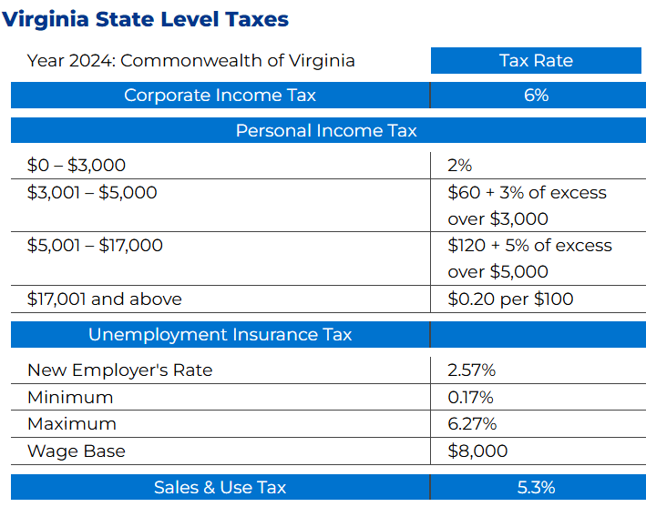
Utility Benchmarking: Richmond, VA
Electricity
Dominion Virginia Power Average Rates:
Industrial: $0.0566 (1,000 kWh demand; 650,000 kWh/month)
Commercial: $0.1031 (40 kWh demand; 14,000 kWh/month)
Residential: $0.1132 (1,000 kWh/month)
(Source: Dominion Virginia Power; bundled rates as of January 1, 2018, cents per kWh)
Natural Gas
Natural gas service in Henrico is provided by Richmond Gas Works, with pressures up to 120 psi.
Researching Rates in Richmond: Currently investigating the rates offered in Richmond, particularly at the technology park. The website has not provided sufficient information, but this research is ongoing to understand and compare price differences between Richmond and Peoples Gas.
32

Slide 33
Pennsylvania Fiber Advantage: Expanding Capacity in Pittsburgh
Everstream expands fiber network to Pittsburgh region: Cleveland-based Everstream announced plans to extend its fiber network into Pennsylvania, which will connect both the Pittsburgh and Philadelphia regions to the company’s high-capacity networks in other cities across the Midwest.
Cross-State Connectivity: Pennsylvania’s fiber network connects to surrounding states, offering broader regional connectivity options and enhancing the state’s appeal for businesses requiring multi-state operations.
Fiber Connectivity in Major Cities: Cities like Philadelphia, Pittsburgh, and Harrisburg have robust fiber networks, providing high-speed internet access and connectivity options for businesses, residents, and government facilities.
Comcast and Verizon: Both companies participate in public-private partnerships to increase fiber connectivity, often with support from state programs. Comcast, for example, is involved in expanding high-speed internet to rural regions through local and state incentives.
33

Slide 34
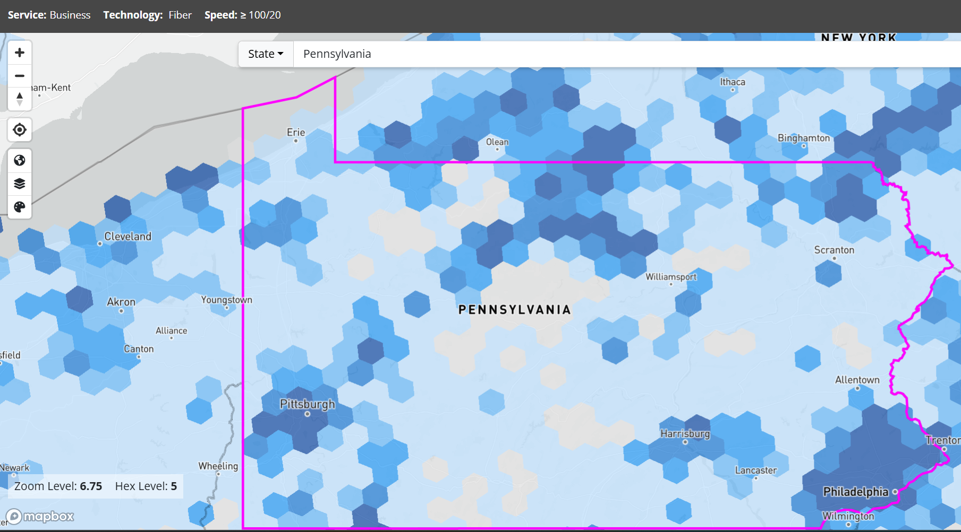
FCC National Broadband Map: Pittsburgh’s Broadband Density and Regional Connectivity Hub
Key Insights: Pennsylvania
The area highlighted in dark blue indicates regions with high fiber coverage, following a graded scale.
In contrast, the greyed-out areas represent zones with no fiber coverage.
Pittsburgh and Philadelphia are two major cities with best fiber coverage, and followed by other regions like Harrisburg and North Central PA.
34

Slide 35
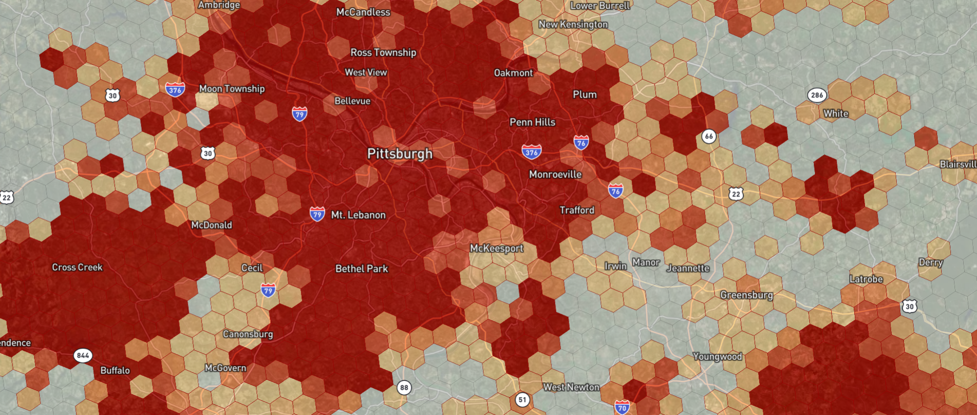
Pittsburgh Fiber Connectivity for Businesses: Local Connectivity Clusters and Data Center Target Zones
Key Insights: Pittsburgh
This image shows that Pittsburgh has strong fiber connectivity around the city, making it well-suited for businesses.
Key areas like Monroeville, Pittsburgh International Airport, McKees Rocks, Oakmont, and Ross Township also benefit from solid fiber coverage.
These locations present a promising future for data centers due to their strong fiber connectivity, access to renewable energy sources, and proximity to key infrastructure for logistics and personnel.
Ross Township, in particular, offers the advantage of lower operational costs while remaining close to Pittsburgh, making it an ideal choice for data center operations outside the city center. These factors combined create an attractive environment for businesses seeking sustainable and cost-effective data center locations.
35

Slide 36
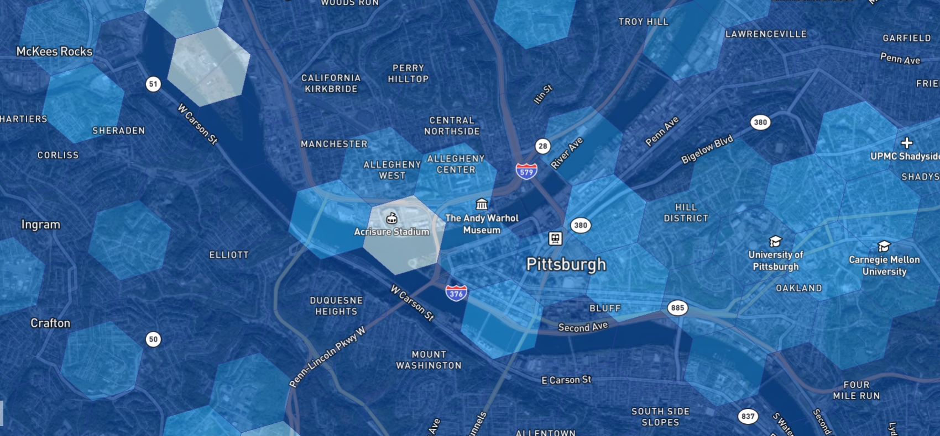
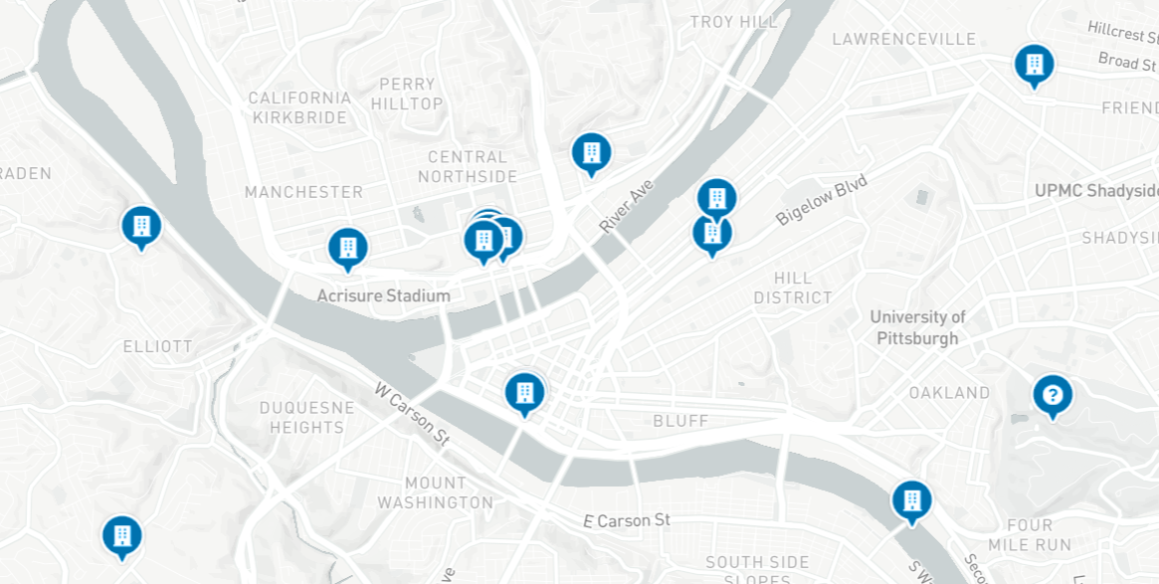



Current Deployment and Performance Benchmark: Fiber Services in Pittsburgh
Most of the current data centers which are situated in Pittsburgh have selected locations where Verizon provides their fiber connectivity business only services.
For example:
Provider: Verizon
Technology: Fiber to Premises
Download (Mbps): 940
Upload (Mbps): 880
Locations: CenturyLink, 100 S Commons
Data centers in Virginia:
CyrusOne Northern Virginia Data Center
Location:21111 Ridgetop Cir, Sterling, VA 20166
Provider: Cogent Communication
Technology: Fiber to the premises
Download (Mbps): 10,000
Upload (Mbps): 10,000
36

Slide 37
Coal Sites: Targets for Data Center Redevelopment
Site Name | County | Current Status | Site Features | Peoples Gas Opportunity
Mitchell Power Station | Washington | Planned redevelopment under DCED & POWER program; shovel-ready lite status possible | 856 acres, river/barge access, Mariner East pipelines, West Penn substation, rail, PA TPK 43 frontage | Direct Peoples pipeline access; ideal for pilot data center + gas co-gen campus
Homer City Station | Indiana | Decommissioned 2023; redevelopment interest but no active buildout underway | 2,000+ acres, 345kV grid tie-in, gas corridor, road access | Flagship site with massive power potential; Peoples can partner for co-gen deployment
Bruce Mansfield | Beaver | Decommissioned 2019; early-stage reuse concepts ongoing, not fully committed | River access, transmission tie-in, near Shell cracker and fiber corridors | Potential cooling + logistics hub; leverage proximity to Beaver’s industrial base
Elrama Station | Washington | Demolished; limited reuse activity; brownfield, small-scale | Monongahela riverfront, low-density area, access to Peoples infrastructure nearby | Edge data center zone with Natural gas microturbine or backup generation potential
Armstrong Station | Armstrong | Decommissioned; site under Dominion ownership; no active development confirmed | 205 MW site, flat terrain, regional grid tie-in potential | Longer-runway site; Peoples could engage for industrial gas and incentives packaging
Cheswick Generating | Allegheny | Decommissioned 2022; demolition underway | Rail, river, highway access; urban-adjacent site with redevelopment potential | Urban-edge colocation site; Peoples could provide dual-fuel co-gen backup
Titus Station | Berks | Decommissioned; limited reuse activity noted | Smaller SE PA location; some transmission and utility connectivity | Limited strategic fit, but viable as backup/data edge facility
Key Takeaways for Peoples Gas:
Mitchell and Homer City are top-tier opportunities for redevelopment (size, grid tie-ins, and gas infrastructure); Peoples should lead co-development discussions
Mitchell has a full redevelopment playbook backed by DCED.
Use Mitchell as a proof-of-concept campus for clean energy-powered digital infrastructure.
Sites like Elrama and Cheswick are ideal for smaller edge or disaster-resilient data centers, especially when paired with gas-powered microturbines.
Peoples’ pipeline proximity to Mitchell, Elrama, and parts of Armstrong County gives it a strong delivery and pricing advantage over electric utilities.
37

Slide 38
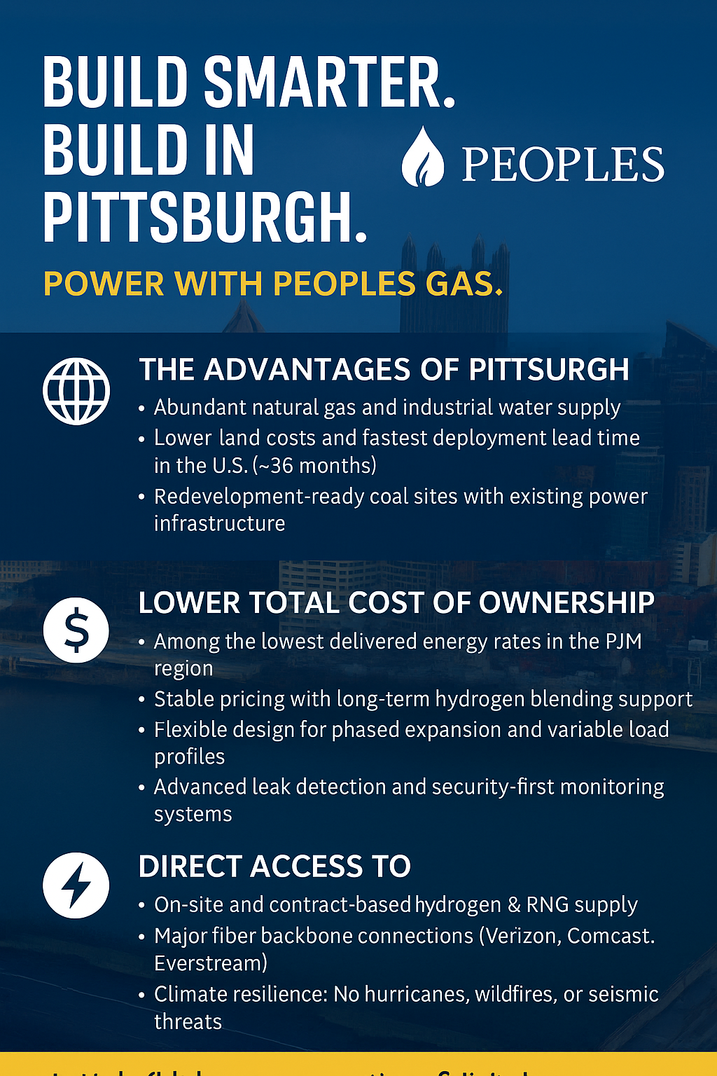
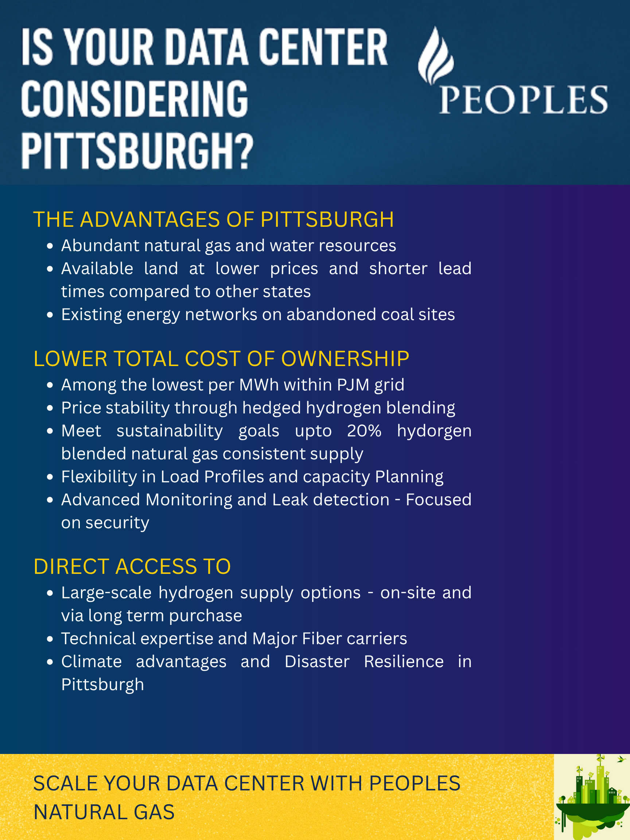
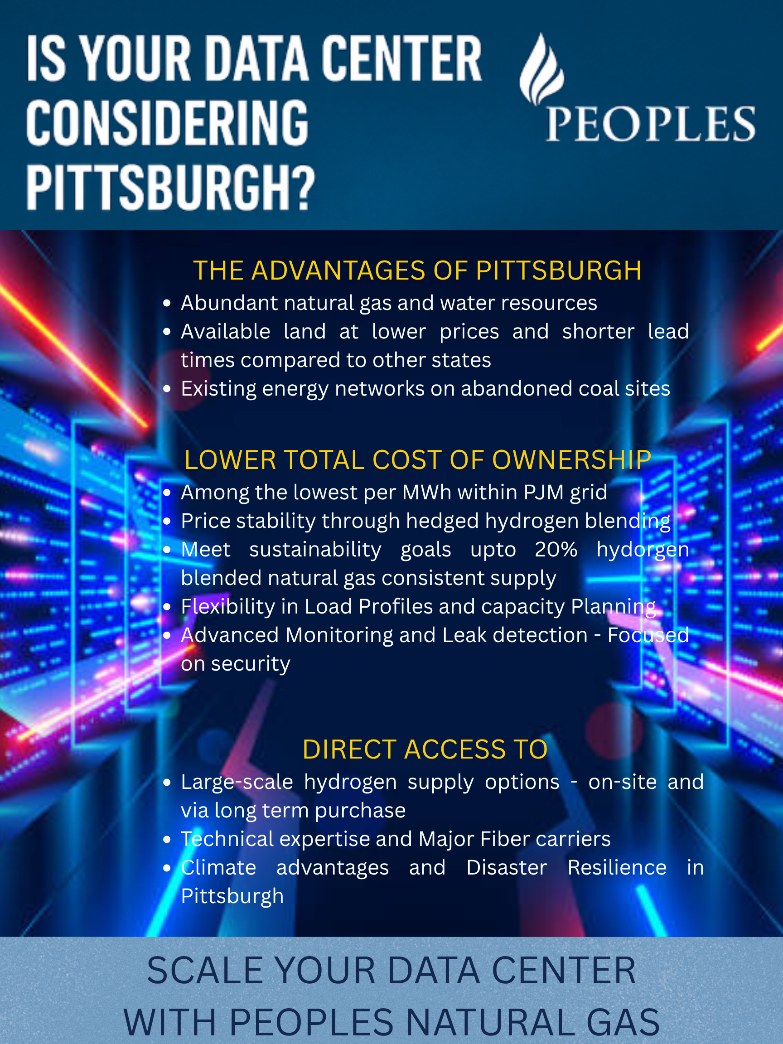
Marketing Campaign Examples: Flyers
38

Slide 39
Clean Fuel Price Comparison
Key Takeaways for Peoples Gas
RNG:
Pros: Pipeline-compatible, carbon-neutral, strong ESG value
Cons: 3–8× more expensive than fossil NG
Use Case: Voluntary ESG programs, state mandates, or niche customers willing to pay green premiums
Green Hydrogen:
Pros: Zero-emission when produced from renewables
Cons: $4–$7/kg = ~$35–$60/MMBtu = ~15–20× more expensive
Use Case: Long-term play. Not cost-competitive for base load power now
Turquoise Hydrogen (H Quest):
Pros: Produced locally from methane with solid carbon byproducts (graphene, carbon black)
Cost-effective (~$2/kg or ~$16/MMBtu) when co-product value is captured
Peoples can support H Quest scaling to offer this fuel under green portfolios
Use Case: Viable mid-term green fuel offering, especially in data center pilots
Fuel Type | Typical Price Range | $/MMBtu Equivalent | ∆ vs. Conventional NG | Feasibility for Peoples
Conventional Natural Gas | $2.25–$3.50/Mcf | ~$2.20–$3.40/MMBtu | Baseline | Existing base fuel
RNG (Renewable NG) | $10–$30/MMBtu | $10–$30/MMBtu | +300% to +800% | High-cost; niche uses or mandates
Green Hydrogen | $4–$7/kg (2025 est.) | $30–$60/MMBtu | +1000%+ | Too expensive for large-scale fuel substitution now
Turquoise Hydrogen | ~$1.80–$2.50/kg (H Quest est.) | ~$13–$20/MMBtu | +300% to +500% | Potential mid-term use via H Quest partnership
Blended Hydrogen (10–20%) | Mixed (blended pricing) | ~$3–$6/MMBtu | +50–100% (blended) | Feasible pilot / ESG premium offering
Recommendation for Rate Strategy:
Short-term: Stick with conventional NG for base case (e.g., $65.08/MWh)
Add optional “Green Fuel Premium” tier with:
RNG blend (e.g., +$15–25/MWh)
Turquoise hydrogen (e.g., +$10–15/MWh)
Position this for ESG-aligned data centers, allowing them to claim Scope 1 emission reductions via green fuel contracts
39

Slide 40
Recommendations and Next Steps – Part 2 Data center
Advocate for Data Center Incentives by partnering with the Pennsylvania Department of Community and Economic Development (DCED)
1. Formal Coalition Building – ✅ Highly feasible
Why it’s doable: Peoples Gas has relationships with DCED, economic development authorities, and local stakeholders. They can easily initiate or co-lead a working group with PEDA, the Allegheny Conference, or Pittsburgh Regional Alliance.
Value: Positions Peoples as a proactive convener and partner in digital infrastructure development.
2. Host or Co-Sponsor a Regional Data Center Incentive Summit – ✅ Feasible
Why it’s doable: Requires only sponsorship and coordination, not regulatory approval.
Value: High visibility event that elevates Peoples' role in the site selection ecosystem and showcases Western PA as “open for data business.”
3. Engage the PUC on Flexible Tariffs or Pilot Rates – ✅ Feasible (with preparation)
Why it’s doable: Peoples already interfaces with the PUC; advocating for opt-in rates for data centers or pilot tariffs is within scope.
Requires: Internal alignment, external rate design consulting, and stakeholder engagement.
Value: Lays groundwork for a differentiated rate structure that could help attract large-load users.
40

Slide 41
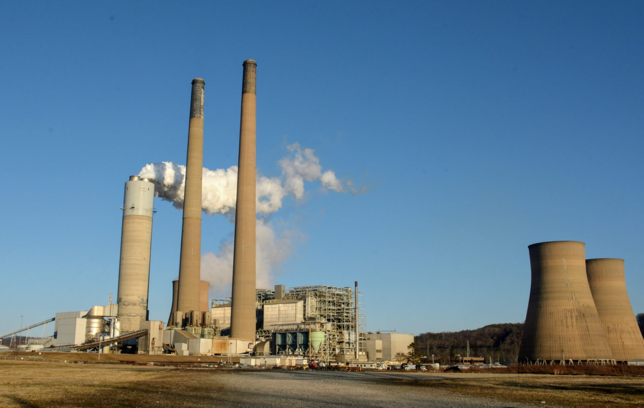
References – Coal sites
1. Mitchell Power Station (Washington County, PA)
Sources:
Mitchell Power Station Redevelopment Playbook (2018)
PA Department of Community & Economic Development
2. Homer City Generating Station (Indiana County, PA)
Sources:
Homer city
Wikipedia: Homer City Generating Station
3. Bruce Mansfield Power Plant (Beaver County, PA)
Sources:
Wikipedia: Bruce Mansfield Power Plant
Bruce Mansfield
4. Elrama Power Plant (Washington County)
Global Energy Monitor Overview: Global Energy Monitor
Observer-Reporter on Demolition: Observer-Reporter
CDRecycler Video on Implosion: Construction & Demolition Recycling
TribLive Article on Redevelopment Plans: TribLive
5. Armstrong Power Station (Armstrong County)
Global Energy Monitor Overview: Global Energy Monitor
Power Technology Profile: Power Technology
6. Cheswick Generating Station (Allegheny County)
Global Energy Monitor Overview: Global Energy Monitor
Charah Solutions Acquisition News: Charah Solutions
TribLive Article on Demolition and Redevelopment: TribLive
7. Titus Station Power Plant (Berks County)
PA DCED Redevelopment Playbook: PA DCED
Yahoo News on Rail Terminal Reopening: Yahoo
Ground News Article on Transformation Project: Ground News
📌 Additional Resources
Coal-Fired Power Plant Redevelopment Playbooks (PA DCED): PA DCED
PNNL Report on Energy-Related Redevelopment Options: PNNL
EPA Superfund Sites in Reuse in Pennsylvania: US EPA
41

Slide 42
References
H Quest. (n.d.). Decarbonizing natural gas at the point of use. Retrieved June 1, 2025, from https://www.h-quest.com/
U.S. Department of Energy, Office of Energy Efficiency & Renewable Energy. (2023). U.S. national clean hydrogen strategy and roadmap (draft). Retrieved from https://www.energy.gov/eere/fuelcells/us-national-clean-hydrogen-strategy-and-roadmap
Pennsylvania Department of Community & Economic Development. (n.d.). Mitchell Power Station – Decommissioning & Redevelopment Playbook. Retrieved from https://dced.pa.gov/programs-funding/coal-plant-redevelopment-playbooks/mitchell-power-station/
Slide 11 - Virginia Economic Development Partnership. (n.d.). Data centers: Virginia’s competitive advantage. Retrieved from https://www.vedp.org/industry/data-centers
Tariff and Rate structure - Pennsylvania Public Utility Commission. (n.d.). Natural gas tariffs – Filing resources. Retrieved from https://www.puc.pa.gov/filing-resources/tariffs/natural-gas-tariffs/
Dominion Energy Virginia. (2025, April 1). Dominion Energy Virginia proposes new rates to continue delivering reliable service and increasingly clean energy [Press release]. Retrieved from https://news.dominionenergy.com
Elias, M. (2025, March 18). Data centers, generative AI & power constraints: The path forward [Presentation at Pennsylvania Data Center & Energy Summit]. Pittsburgh Technology Council
Federal Communications Commission. (n.d.). National Broadband Map. Retrieved from https://broadbandmap.fcc.gov/
GHGSat. (n.d.). GHGSat greenhouse gas monitoring. Retrieved from https://www.ghgsat.com/
Kayrros. (n.d.). Methane Watch. Retrieved from https://methanewatch.kayrros.com/map
City of Philadelphia. (n.d.). Keystone Opportunity Zones (KOZ). Retrieved from https://www.phila.gov/programs/keystone-opportunity-zones/
42

